Slide 1
Exception Handling
IT 301

Slide 2
Exceptions
Exceptions are the object-oriented version of errors
Exceptions mark that something exceptional has happened
A program will need to respond or terminate
Examples:
Opening a non-existent file
Invoking a method on a null object
Dividing by zero
Calculating the square root of a negative number
Empty input from a user (empty string)

Slide 3
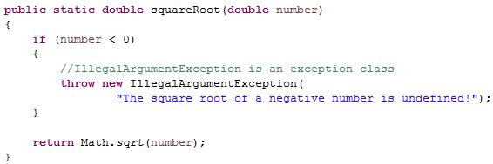
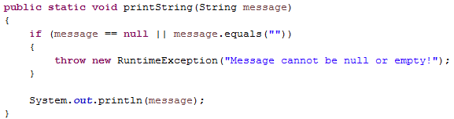
“Throwing” exceptions
To mark an exception situation, use the throws keyword

Slide 4
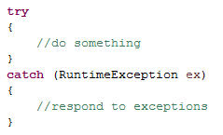
The try-catch structure
Try-catch blocks are used to prevent program termination and respond to exceptions
code segment that
may result in an
exception
respond to exception

Slide 5
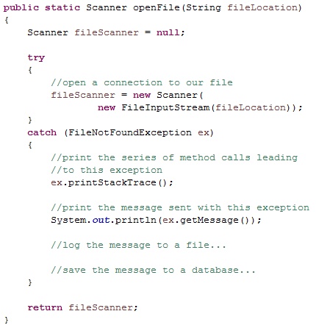
The try-catch structure
Ways to respond
Printing messages to the user
Printing debug messages for the developer
Stack trace
Variable values
Logging an error message to a file
Logging an error message to a database

Slide 6
Popular descendants of Exception
Error
Exception
IOException
ClassNotFoundException
CloneNotSupportedException
RuntimeException
EOFException
FileNotFoundException
MalformedURLException
UnknownHostException
ArithmeticException
ClassCastException
IllegalArgumentException
NumberFormatException
IllegalStateException
IndexOutOfBoundsException
ArrayIndexOutOfBoundsException
No SuchElementException
InputMismatchException
NullPointerException
Throwable

Slide 7
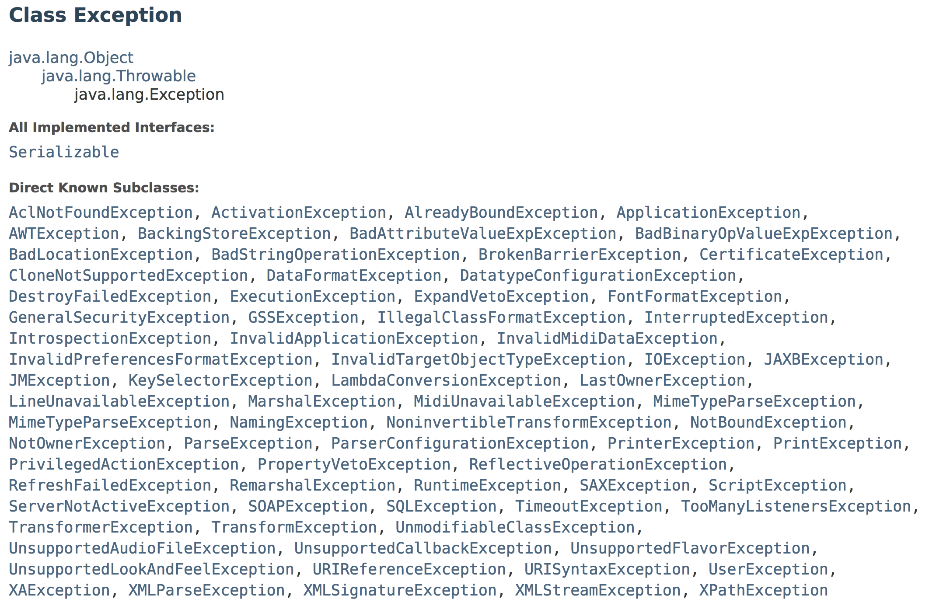
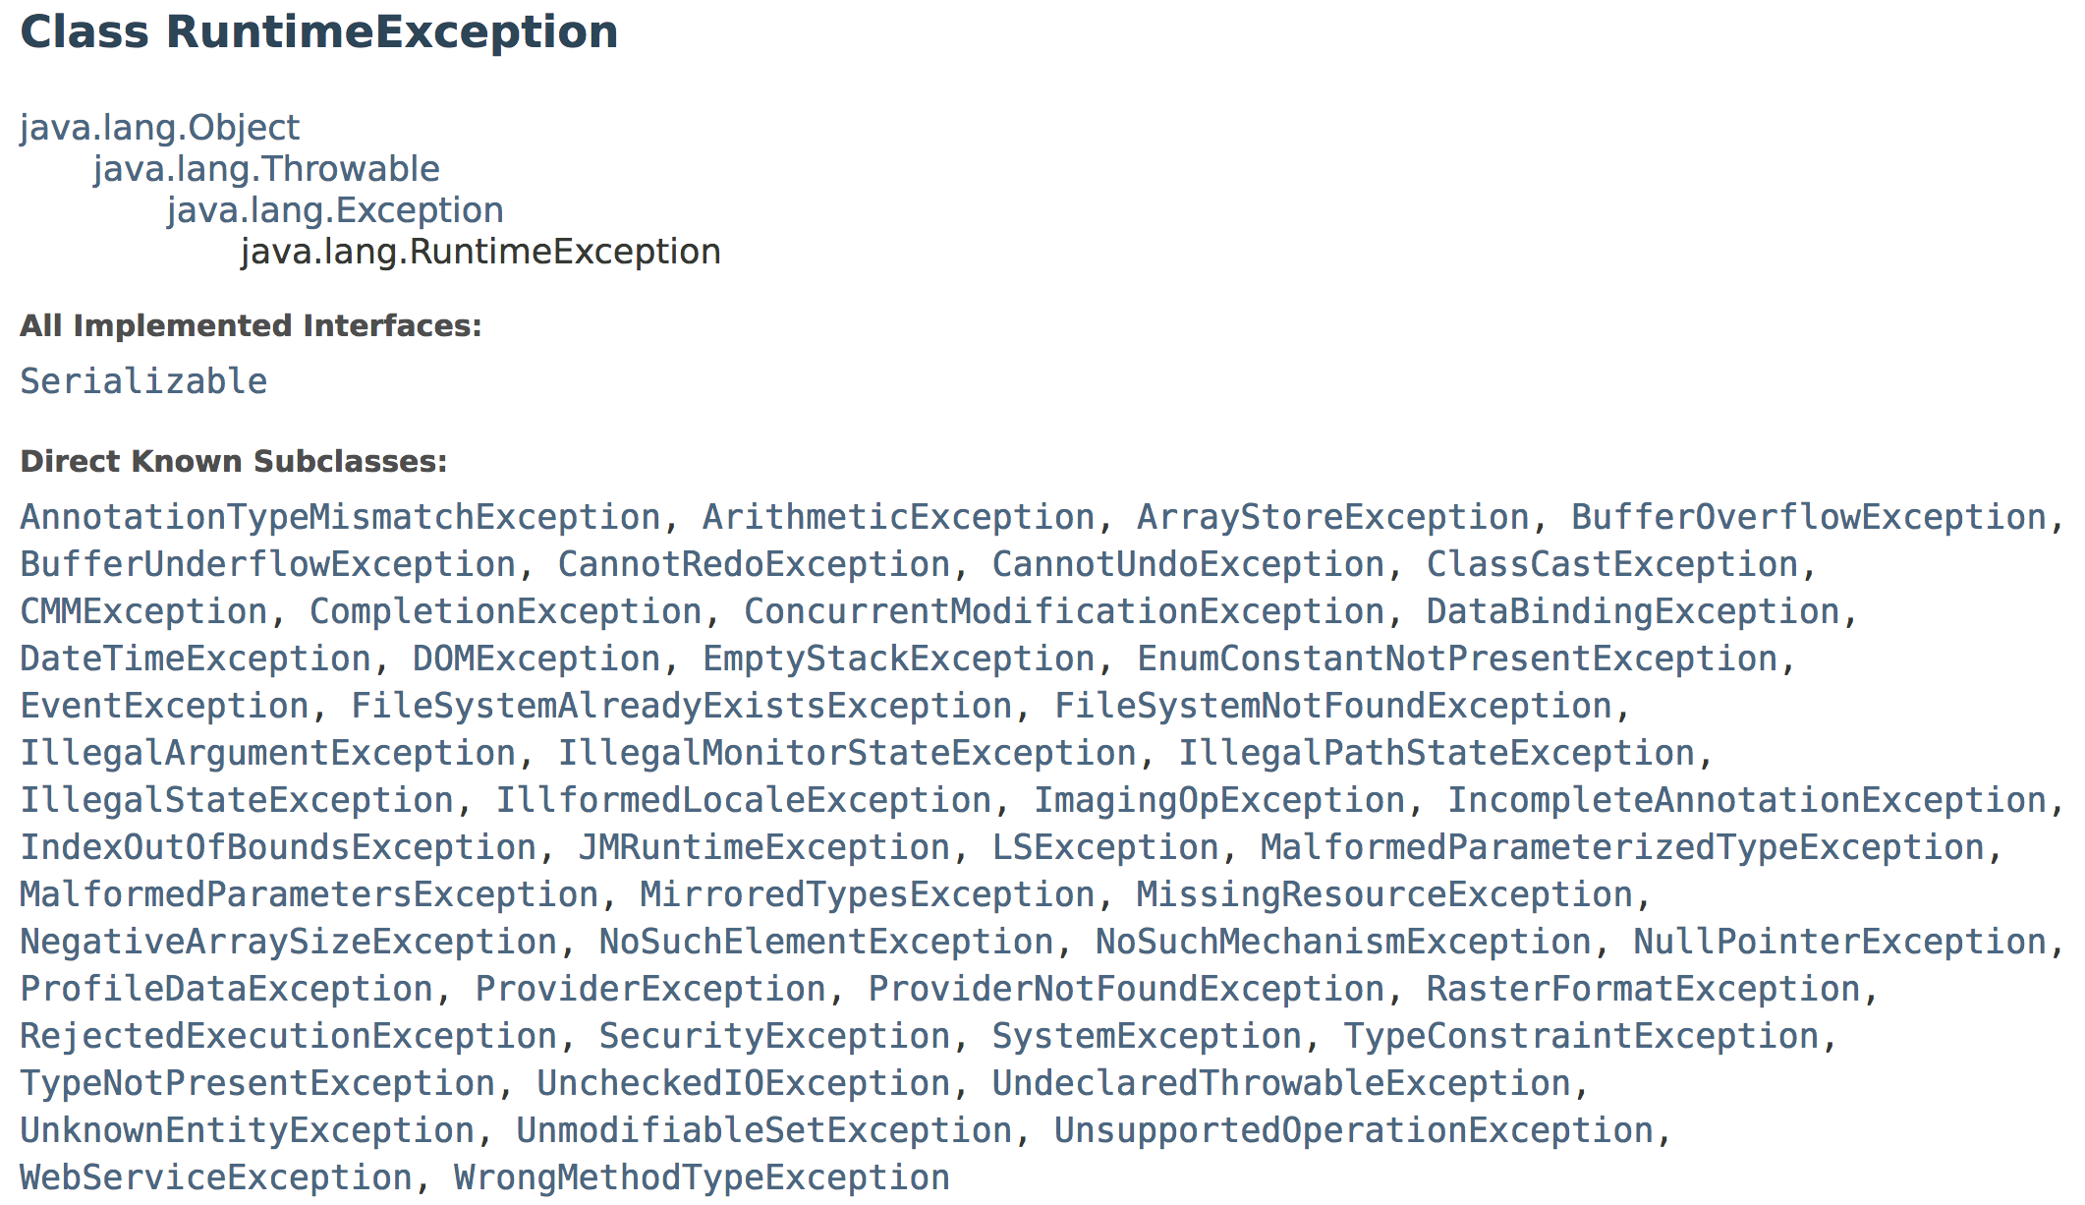
And even more!

Slide 8
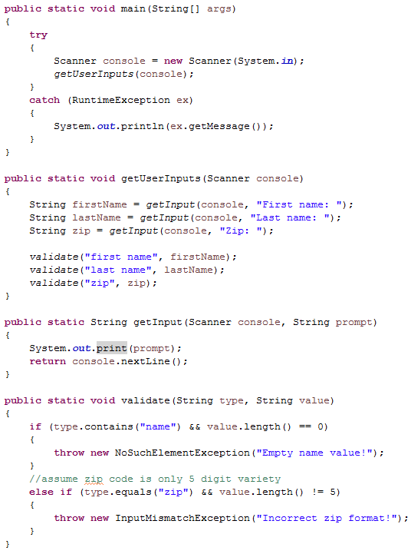
Exception handling resolution
Exceptions may be buried deep among multiple method calls

Slide 9
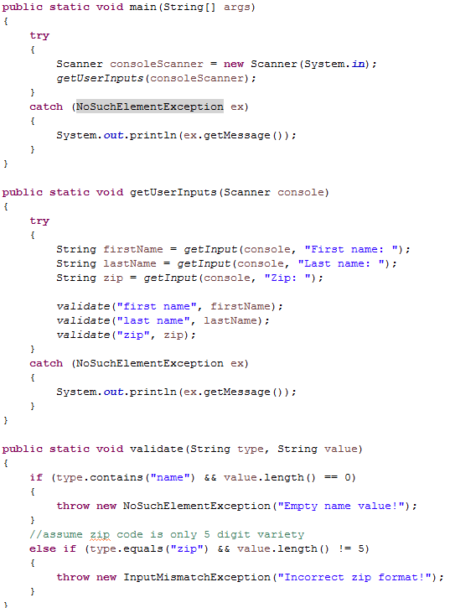
Exception handling resolution
Exceptions may be contained in multiple try-catch blocks
How many try-catch blocks surround validate()?
Caught by
the last
enclosing
try-catch
block

Slide 10
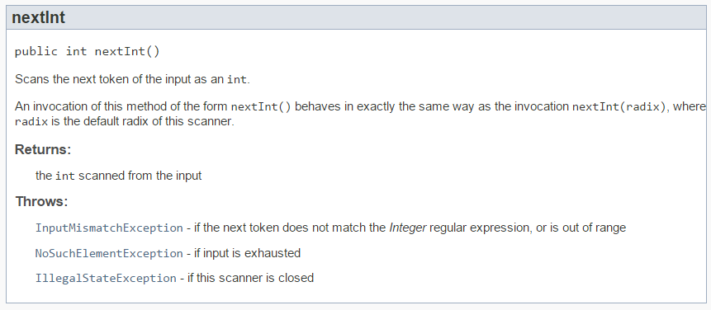
Exception handling resolution
Exceptions may be outside of the code you have written
Know your API!

Slide 11
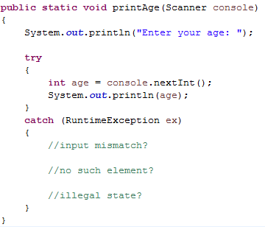
Exception handling resolution
How should I respond if
The scanner is closed?
The input is not a number?
The number is outside the range of an int?

Slide 12
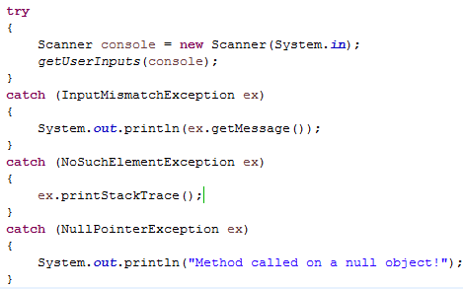
Multiple try-catch blocks
You can include any number of catch blocks in a try-catch structure
When an exception is thrown each block is checked for a matching type from top to bottom
resolution

Slide 13
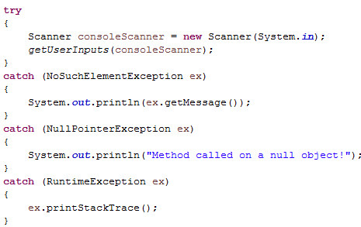
Multiple try-catch blocks
What happens if any of the following exceptions are thrown?
NoSuchElementException
Print message in “ex”
InputMismatchException
Print message in “ex”
IllegalStateException
Print stack trace
FileNotFoundException
Program terminates!

Slide 14
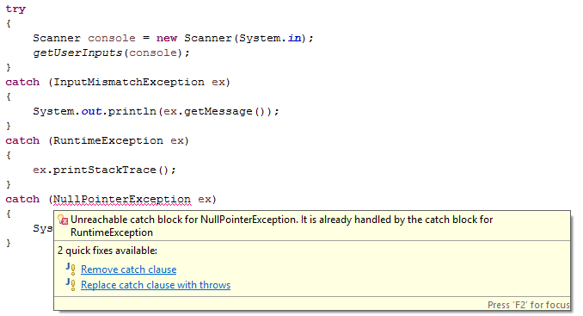
Multiple try-catch blocks
The order of your catch blocks is important

Slide 15
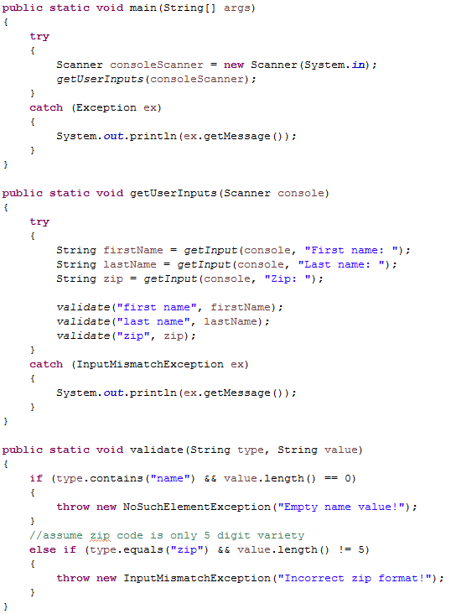
Multiple try-catch blocks
Which catch block will catch a InputMismatchException?
Caught by the last enclosing try-catch block with a matching type

Slide 16
Multiple try-catch blocks
Which catch block will catch a NoSuchElementException?
A NoSuchElementException is an Exception
A NoSuchElementException is not an InputMistmatchException

Slide 17
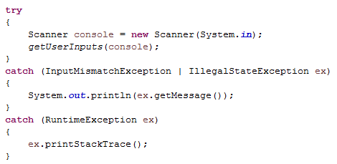
Shared catch blocks
With Java 7 a single catch block can have more than one type

Slide 18
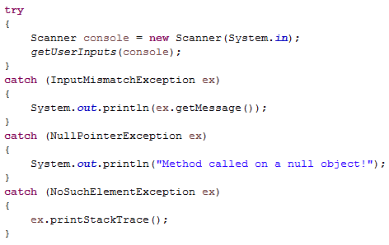
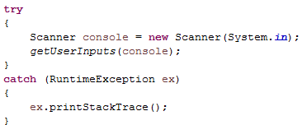
Exception handler design
Is it better to have several catch blocks or one catch-all block?
What are the pros/cons of each design?

Slide 19
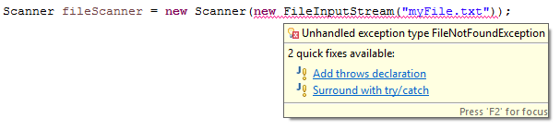
Check vs. unchecked exceptions
There are two types of exceptions in Java, checked and unchecked
Checked exceptions require try-catch blocks
Unchecked exceptions do not

Slide 20
Checked vs. unchecked exceptions
More specifically:
Checked exceptions are subject to the catch-or-declare rule
Catch-or-declare rule:
A checked exception must be surrounded in a try-catch block OR the method it is contained within must declare that it “throws” the exception
Any method that interacts with this method is then subject to the catch or declare rule

Slide 21
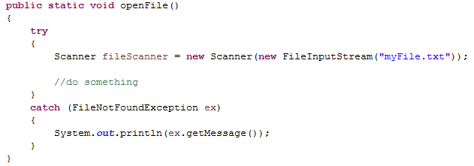
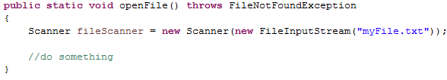
Catch-or-declare rule
Catch
Declare

Slide 22
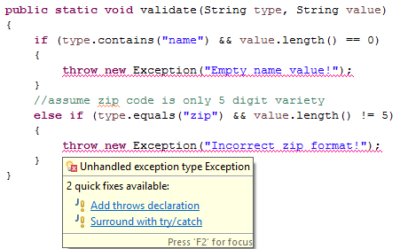
Passing the buck!
Checked
Exceptions

Slide 23
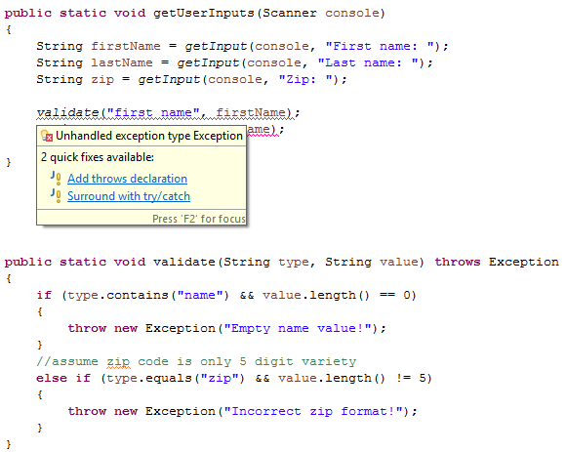
Passing the buck!
Pass the
responsibility
to methods
that invoke
this method

Slide 24
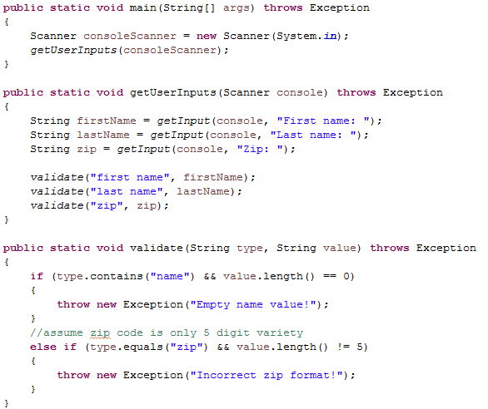
Don't keep passing the buck!
Java added checked exceptions for a reason
Even if you don't agree with the design, you should not ignore it!

Slide 25
Check vs. unchecked exceptions
Error
Exception
IOException
ClassNotFoundException
CloneNotSupportedException
RuntimeException
EOFException
FileNotFoundException
MalformedURLException
UnknownHostException
ArithmeticException
ClassCastException
IllegalArgumentException
NumberFormatException
IllegalStateException
IndexOutOfBoundsException
ArrayIndexOutOfBoundsException
No SuchElementException
InputMismatchException
NullPointerException
Throwable
checked
unchecked

Slide 26
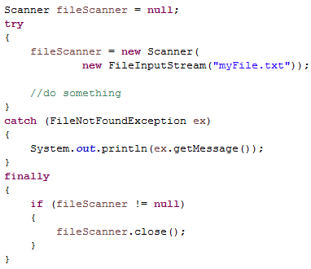
IO and the finally block
You can add a finally block to any try-catch
It is guaranteed to run
If no exception is thrown
If an exception is thrown and caught
If an exception is throw but not caught
We need to ensure
that we close our
file resource!

Slide 27
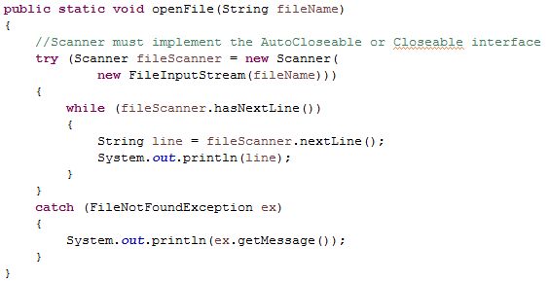
Try-with
Used to close system resources automatically
Scanner is closed with no further
code after our try-catch completes

Slide 28
Custom Exception classes
You can declare your own custom Exception classes
Your class must inherit from Exception or an ancestor of the Exception class (such as RuntimeException)
If your class inherits from a checked exception your class will be checked
If your class inherits from an unchecked exception your class will be unchecked

Slide 29
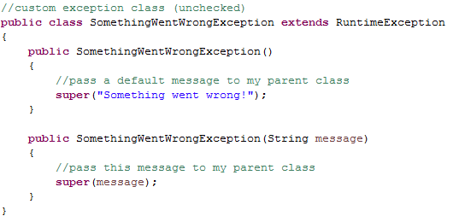
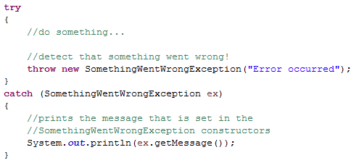
Custom Exception classes

Slide 30
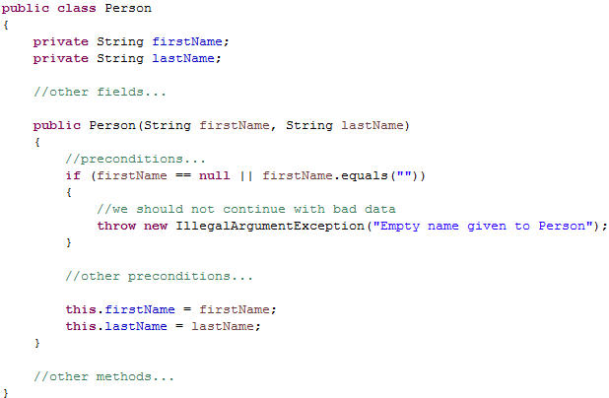
Two perspectives of Exception Handling
Perspective A: "I design a useful class, with interesting functionality. If something goes wrong I throw an Exception and I'm done."

Slide 31
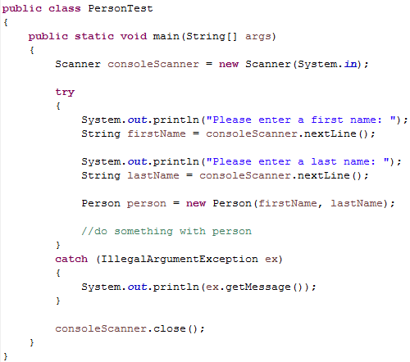
Two perspectives of Exception Handling
Perspective B: "I'm using a useful class that I (or another developer) created. If something goes wrong I should respond to it."

Slide 32
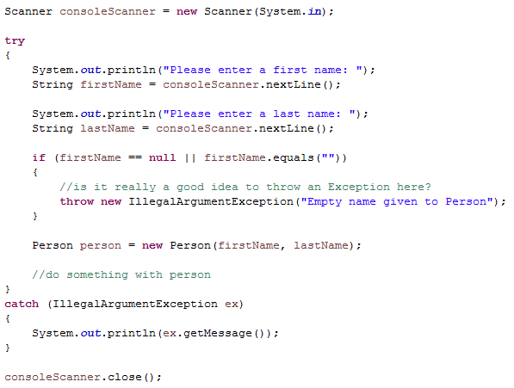
Two perspectives of Exception Handling
Don't mix these perspectives together!

Slide 33
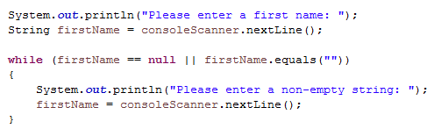
Two perspectives of Exception Handling
Do we really need Exceptions in this case?
Can't we just use regular control flow structures?
Never use Exceptions to manage the control flow of your program!

Slide 34
Exception Handling
IT 301

